Slide 1


Language Translators: Compilers vs. Interpreters
How Computers Execute High-Level Code
M.V.Rakesh Reddy(192524164) CSA1407 - COMPILER DESIGN

Slide 2



Why Do We Need Language Processors?
The Problem
Humans write code in High-Level Languages (HLL) like C++, Java, or Python for readability. However, hardware processors can only execute Machine Code (0s and 1s).
The Solution
We require a Language Translator to bridge the gap between human logic and binary machine instructions.
Two Main Approaches
1. Compilation: Translates the entire code at once. 2. Interpretation: Translates and executes line-by-line.

Slide 3

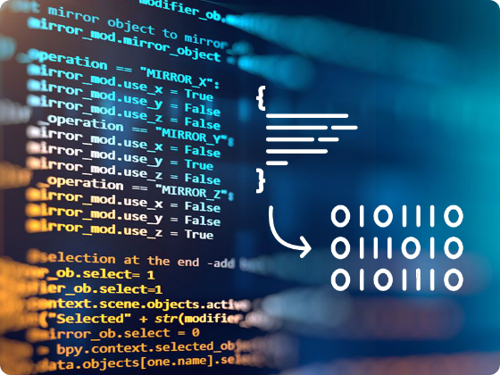
What is a Compiler?
A Compiler reads the entire source program, translates it into machine/object code, and saves it as an executable file ( / ).
Source Code
Compiler
Object Code
Execution
Speed: Initial compilation takes time, but subsequent binary execution is extremely fast.
Memory: Requires more memory to store the intermediate target object file.
Error Handling: Scans the whole file and reports all errors together at the end.
PRIMARY LANGUAGES:

Slide 4


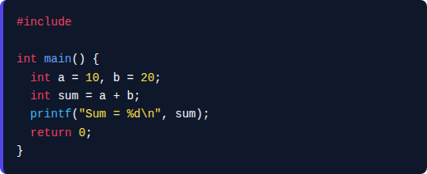


Compiler Workflow: C Code Execution
Compiler Workflow: C Code Execution
C Source Code (main.c)
1. Preprocessor (gcc -E main.c)
Expands header files (#include), replaces macros (#define), and strips comments $\rightarrow$ generates main.i.
Source program compiled ahead-of-time (AOT):
2. Compiler (gcc -S main.i)
Performs lexical, syntax (AST), and semantic analysis $\rightarrow$ optimizes and translates C into target CPU Assembly (main.s).
3. Assembler (gcc -c main.s)
Translates assembly mnemonic instructions into machine binary object code (main.o).
4. Linker & Execution (gcc main.o -o app)
Links object code with C standard runtime libraries (libc) $\rightarrow$ OS loads binary executable into RAM for CPU execution.

Slide 5
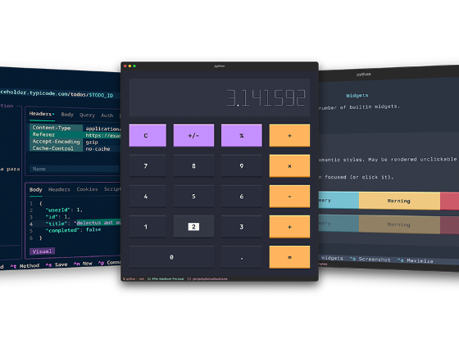
What is an Interpreter?
An Interpreter processes high-level code line-by-line, translating and executing each line immediately before moving to the next.
Source Line
Interpreter
Immediate Output
Speed: Starts running instantly, but total execution is slower for loops and large programs.
Memory: Less memory intensive as no intermediate object file is created or saved.
Error Handling: Halts execution immediately at the exact line an error occurs.
PRIMARY LANGUAGES:

Slide 6

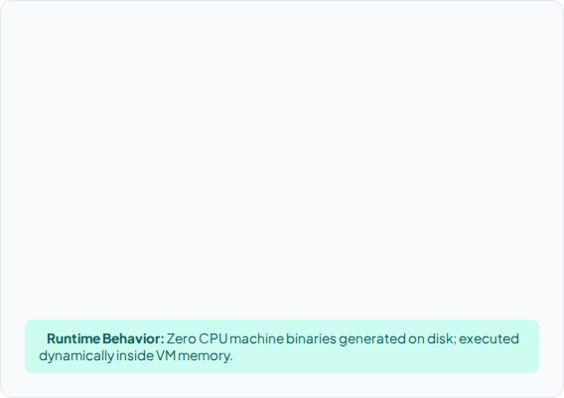

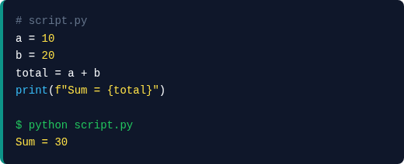

Interpreter Workflow: Python Code Execution
Interpreter Workflow: Python Code Execution
Python Script (script.py)
1. Tokenizing & Parsing
Python lexer/parser converts raw source code into tokens and builds an Abstract Syntax Tree (AST).
Source script executed via CPython runtime:
2. Bytecode Compilation
AST is compiled into intermediate Python Bytecode instructions (opcodes like LOAD_CONST, BINARY_OP) stored in memory (or .pyc cache).
3. Python Virtual Machine (PVM Loop)
The PVM evaluation loop (ceval.c) reads bytecode opcodes sequentially and evaluates them dynamically.
4. Dynamic Runtime Execution
Handles dynamic typing and memory management, executing corresponding host CPU instructions and displaying output instantly.

Slide 7
Key Differences Summary
Feature | Compiler | Interpreter
Translation Strategy | Translates the whole program at once | Translates line-by-line sequentially
Execution Speed | Fast (Pre-compiled binary) | Slower (Translated on the fly)
Target Code Saved? | Yes (e.g., .exe, .o files) | No target code stored on disk
Error Debugging | Harder (All errors listed at once) | Easier (Stops on first error)
Memory Usage | Higher (Requires object code storage) | Lower (No intermediate binary)
Primary Languages | C, C++, Rust, Go | Python, JavaScript, Ruby, PHP

Slide 8






Hybrid Approach: JIT Compilers
Modern language environments combine both strategies for optimal portability and runtime performance.
1. Source Code
2. Bytecode
3. JIT Execution
High-level language source code written by developers (e.g., Java or C# files).
An intermediate compiler converts source code into portable Bytecode () rather than machine binary.
The Virtual Machine (JVM / .NET) interprets bytecode and uses a Just-In-Time (JIT) compiler to translate frequent "hot spots" to machine code.

Slide 9



Summary & Key Takeaways
Compilers = High Performance
Compilers optimize for maximum execution speed. They are the standard choice for system software, game engines, operating systems, and embedded computing.
Interpreters = Flexibility & Speed of Development
Interpreters optimize for developer iteration and portability. They excel in rapid prototyping, web development, data science, and scripting.
Foundation for Compiler Design
Understanding how language processors handle parsing, translation, and code generation forms the core foundation of our course in Compiler Design.

